Slide 1
MS WORD ASSIGNMENT
BY ABDUL WAHAB AMIIR

Slide 2
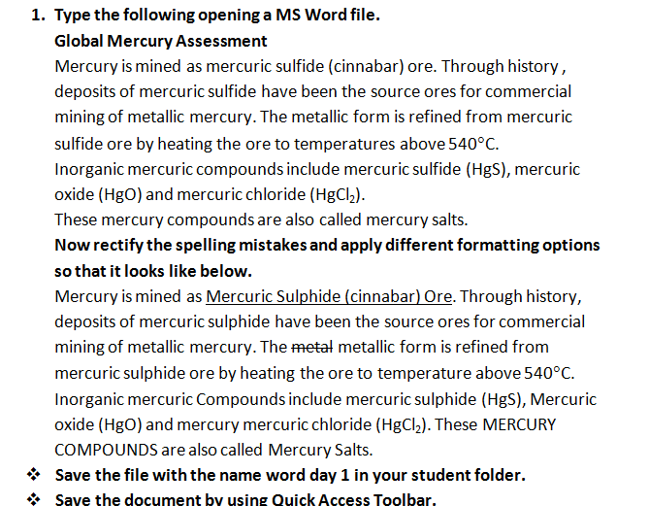

Slide 3
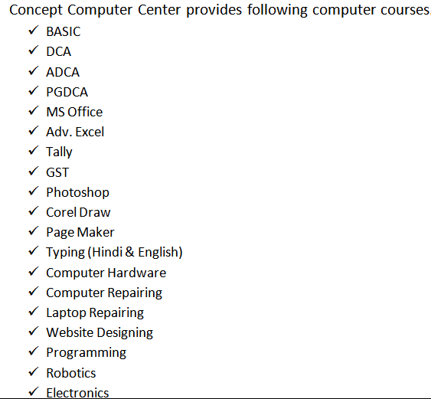

Slide 4
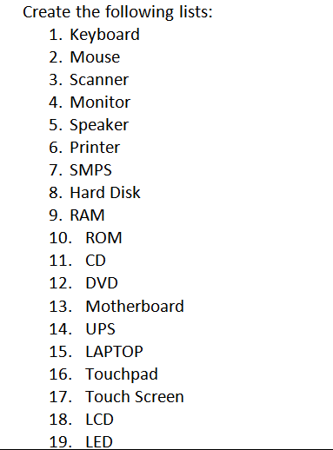

Slide 5
